Slide 1
LatentView Top 25 Case Studies

Slide 2
‘Customer Focused’ Case Studies
2

Slide 3


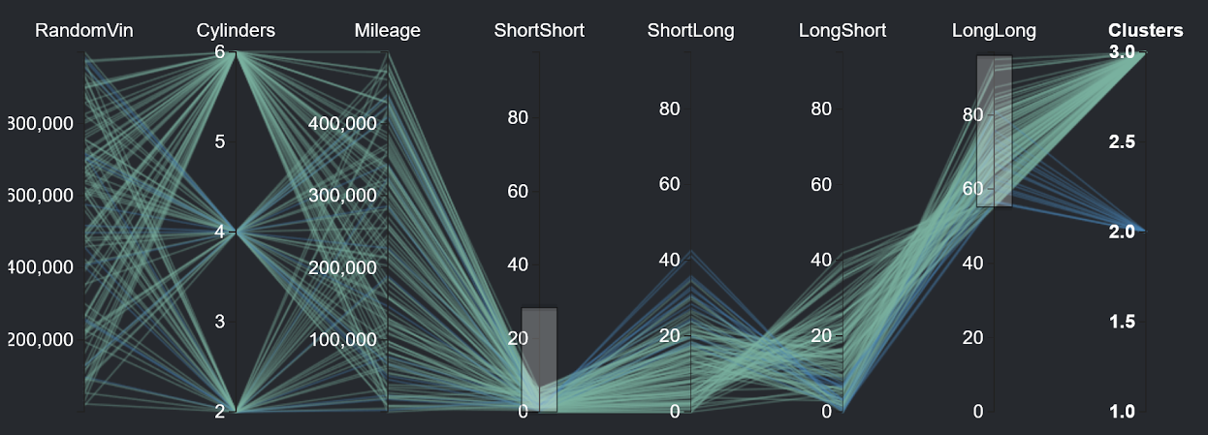
Risk Identification By Modeling Customer Behavioral Patterns
Europe-based Iconic Automobile Manufacturer
The Problem: Costs incurred due to warranty claims had a negative impact of almost 2.5% on the bottom line
The “Before” State
LatentView Solution
The “After” State
Warranty claim predictions were based on an historical average computed across all categories of drivers
Driving styles were identified based on vehicle usage and historical warranty claims which were then used to accurately predict future claims for each driving style
Warranty costs reduced by 35% for the “long pause and short trips” driving style due to proactive ‘drive right’ messaging communicated to at-risk drivers
Controller Readout Data
Hypothesis Testing Tool
Output
C1 – > 30K/Yr, 30% Long Trips, 25% - Acceleration > 200KMPH
Typical Issues:
Head Gasket Failure, Soot in the oil, Engine mount issues
Calculated Risk: €2.400,00
Risky Clusters: C2, C6
Cause: High Acceleration in winter without heating
3
Notes:
BMW – Hypothesis Testing
Business Objective:
Improve the throughput in production line for a plant having Operational Equipment Efficiency (OEE) due to impact of packaging segment stops contributing to fryer downtime / throughput reduction
LatentView Solution:
Driving Styles
Identify key driving styles using the vehicle controller data
What are the main driving styles?
Warranty Claims
Compare driving styles with warranty claims data
Are there claim patterns to individual styles?
Automated Hypothesis Testing
Use the tool to identify risk groups by dynamic profiling
Continuous Hypothesis Testing
Process:
Data collected:
1) Vehicle Usage from Connected Data - Driving Styles
2) Warranty & Repair Data - Repairs & Risk Patterns
Output:
Driver Segmentation, Risk Prediction & Maintenance at each Car (VIN) level

Slide 4




Recommendation System to Increase Share of Wallet
Largest Food Distributor in US
The Problem: In an industry where customer acquisition is fairly expensive, this company’s repeat orders were at a low 4%
The “Before” State
LatentView Solution
The “After” State
Sales teams tried to sell new products to existing customers based on shallow analysis of previous transactions and ‘gut’ feel
Build an innovative recommendation engine that combined customer segmentation, user-based collaborative filtering and market basket analysis
20% increase in value of new orders from existing customers. Higher customer satisfaction due to precise recommendations
Collaborative Filtering
Market Basket Analysis
Items Purchased:
Items Purchased:
Market Basket Analysis performed for all products bought by customers in a segment. Select the product with highest likelihood to co-occur in the basket
Similar
Customer B
Milk
Eggs
Milk
Eggs
Bread
MILK | EGGS | OLIVES | BREAD
Customer A
Customer C
TRX1
Milk
Eggs
TRX2
Recommend Bread
User-User Similarity - similarity is calculated between customers within a segment based on common products in basket using Cosine Similarity
TRX3
Recommended
Bread
TRX4
Recommendation Engine
Combine the recommendations from the 2 algorithms to generate the final recommendation
For a Customer who purchases Milk & Eggs, the product with highest affinity is Bread
4
Notes:
Sysco – Recommendation Engine
Business Objective:
Analyze the sales transaction files to recommend new items for each individual customer to purchase. These recommended items should not have been purchased by the individual customer in the past
Identify products that frequently co-occur in a basket to strengthen the cross sell recommendations
Prioritize recommendations based on Customer Value
LatentView Solution:
The methodology can be divided into three parts
Customer Segmentation
User Based Collaborative Filtering:
Market Basket Analysis
Final Recommendations: Generate the final recommendations by combining the collaborative filtering and market basket analysis outputs
Business Benefits:
With the help of the recommendations generated, potential customers can be targeted for cross-selling
Prioritizing the customers to be targeted using the RFM scores generated for each customer

Slide 5
Churn Prediction using Machine Learning
Leading Global Technology Infrastructure Provider
The Problem: Customer Lifetime Value of existing customers is nearly twice that of new customers and hence retention is key to profitability
The “Before” State
LatentView Solution
The “After” State
No scientific methodology to identify potential attrition among existing clients
Developed a ‘random decision forests’ based attrition prediction model with invoices, contracts and order data after appropriate data preparation and feature engineering
90% accuracy in predicting potential churn customers which helped client take appropriate measures to retain customers with high CLV
Data Sources
Data Aggregation
Preliminary
Analysis
Data Profiling
Model
Identification
Evaluation
UCM, Invoice, IB, Orders, Contracts, BCM
Feature Identification – Stage 1, Quality of Data
Feature roll up methodology, Data Merge
Univariate and Bivariate analysis, Correlation
Regularized Random Forest & Ensemble Model
Confusion Matrix – Precision & Recall
Confusion Matrix - Recall
 | C | G | R | S
C | 89.2% | 0.0% | 7.5% | 3.3%
G | 0.0% | 89.7% | 2.0% | 8.3%
R | 3.7% | 0.9% | 89.8% | 5.6%
S | 0.10% | 10.8% | 0.9% | 88.2%
5
Notes:
Equinix – Churn Modelling
Business Objective: To provide system and method to identify growers, reducers & churners at asset level for all the data centres
Solution:
The 3S framework:
Initial State
Churn & reduction of footprint is evident in the last few years
Currently, there is no scientific way of identifying churners upfront
Sales team use some rules based approach
Proposed State
Able to identify potential churners and reducers upfront in a more accurate and scientific manner
Bring down loss of revenue due to churn by taking proactive measures
Solution
LatentView to provide system and method to identify growers, reducers & churners at asset level for all data centres
The predictions will be for 3,6,9 & 12 months

Slide 6
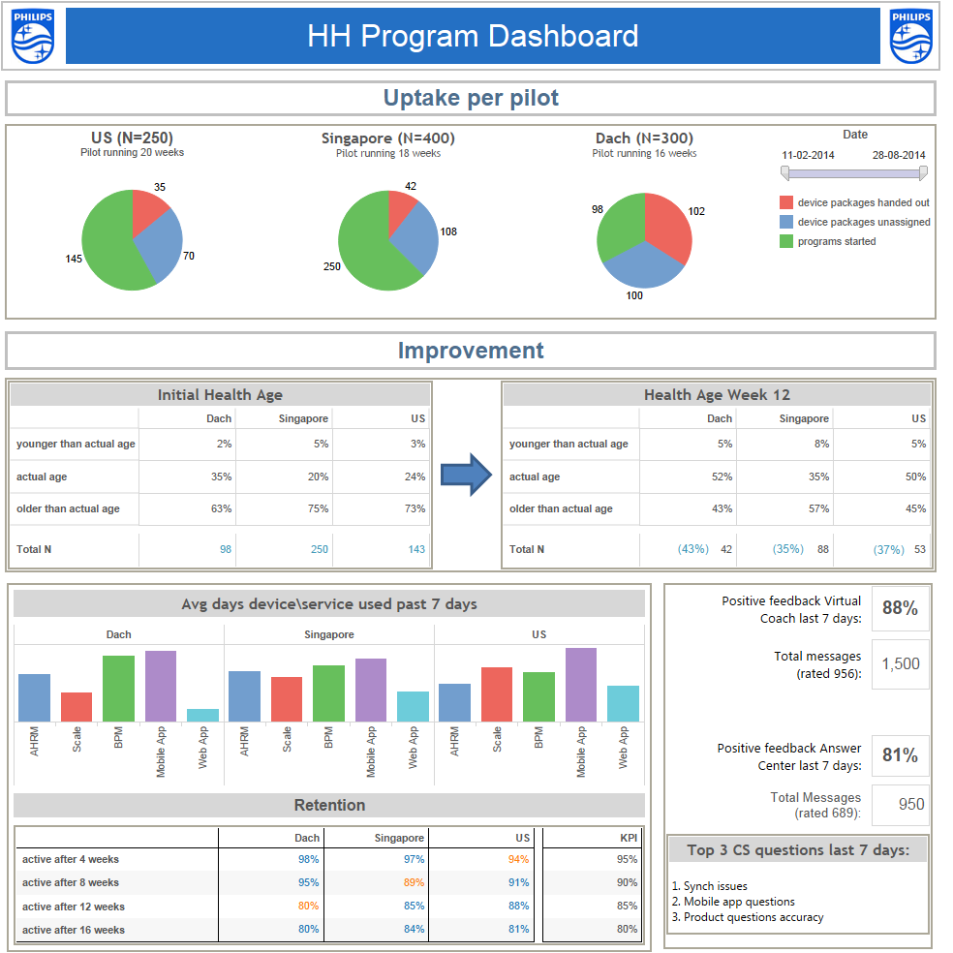


Driving Better Health Outcomes leveraging Wearable Technology
Leading Global Consumer Electronics Giant
The Problem: Difficulty in monitoring consumer actions on lifestyle and healthcare recommendations and deriving insights
The “Before” State
LatentView Solution
The “After” State
No diagnostic insights obtained on data collected from wearable devices and thus the feedback loop between ‘advice and action’ was not clearly established
Comprehensive monitoring of programs enabled through intuitive dashboards created from data on aggregated user profiles and their behavior with the ability to slice and dice data at multiple levels
Relevant interventions were possible due to data driven insights which led to increase in customer satisfaction scores by 50 basis points
User Profile Data
Device Monitor Data
Coaching & Web Interface Data
6
Notes:
Philips – Wearable Devices Dashboard
Business Objective:
Client is a leading global consumer electronics giant
Program for improving the Health of consumers by Measuring, Monitoring and Motivating using wearable devices was implemented.
Data points around the wearable devices are huge and needs an Inquisitive and Intelligent reporting solution.
LatentView Solution:
Data Aggregation:
Program related data are added on to database.
User profile data, Device monitoring data
Coaching & Web Interface data
Rationalization of data from different stakeholders was done to optimize the data base linked to the dashboard
Dashboard Ideology:
Hypotheses for the Insight generation was undertaken and dashboard elements were designed accordingly.
Dynamic dashboard with frequent data updates with automatic refresh of charts was the Ideal solution
Business Benefits:
Customization and Quick Turnaround of dashboard for different business users was accomplished.
Insights generation at different levels of granularity were made available
Hypotheses were developed considering all stages of the health program lifecycle.

Slide 7






Early Warning System to Enhance Customer Satisfaction
Fortune 500 Technology Hardware Company
The Problem: In the hardware services space, preventive maintenance is 40-45% cheaper than ‘after the event’ corrections, but to prevent, one needs to precisely predict service requests (SRs) that can turn critical
The “Before” State
LatentView Solution
The “After” State
Account Managers through manual inspection flag critical SRs which lead to errors and person dependent situation
Utilized text analytics techniques to extract behavioral data which was combined with structured data like service logs to generate predictions on each SR turning critical
Early Warning System (EWS) with over 95% accuracy in predicting critical SRs saved the client $ 20 million per quarter
Keyword Extraction
Supervised
Learning
Part of Speech Tagging
Critical SR probability = 0.8
Unstructured Data
Structured Data
Pre-structured Data
Feature Tagging
Critical SR probability = 0.6
Log
Critical SR probability = 0.5
Sentiment & Theme Evaluation
Text Mining Framework
Analytical Approach
7
Notes:
Cisco - Early Warning System
Notes:
Business Objective:
A POC to build an Early Warning System (EWS) to predict the probability of an incoming service request (SR) turning CAP.
LatentView Solution:
Phase 1 - Data Profiling
Phase II - EWS – Model building for Structured Data
Phase III - EWS - Model for Unstructured Data
Finding Recommendations
Business Benefits:
Phase I - Nearly 90% of the SR’s raised had initial severity level 3 for the period of Jan-Mar 13’
Incidents with severity level 3 and resolved within 8 days and severity level 4 have a very low probability of turning CAP
The structured model captures 85% of the CAP SRs within 10% of the total SRs
Model with unstructured data captures 90% CAPs within 10% of SRs, whereas model with structured data captures only 85% CAPs
Model recommends that 5000 SRs should be serviced as potential cap SRs when 3 months of SR data are used for scoring
The overall benefit of servicing 5000 SRs recommended by the model would be around $30 Million

Slide 8
‘Marketing’ Case Studies
8

Slide 9
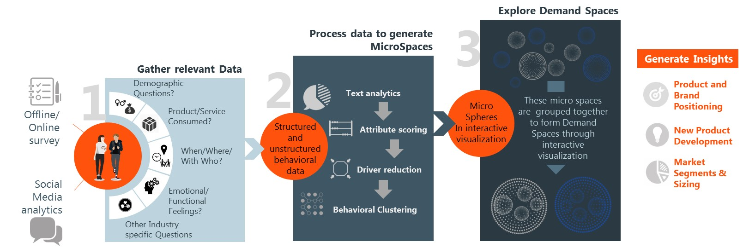
Demand Spaces drives Segmentation in the New Digital Age
Leading Global Food & Beverages Corporation
The Problem: In the digital age, traditional customer segmentation based on demographic profile is ineffective as consumers no longer fit demographic conventions
The “Before” State
LatentView Solution
The “After” State
Segmentation, targeting and positioning of products was primarily based on demographic and psychographic attributes thus limiting scope of the brand and product reach
Customer segmentation and positioning was based on ‘occasions of use.’ This is modeled as ‘micro spaces’ and ‘demand spaces,’ using a data-driven analytical approach that combines survey & social data
Identification of new consumption ‘hot spots’ and activation of occasion-based marketing messages led to an increase of 2-5% in market share across a range of beverage and snack brands
9
Notes:
Pepsi Social Media Analysis – Demand Spaces
Business Objective:
To create a mutually exclusive and collectively exhaustive list of Opportunity/Need Spaces. The Opportunity Spaces are mapped through an in-depth understanding of consumer choices and interaction patterns of these choices with product categories.
LatentView Solution:
User generated conversations on social media once analyzed in-depth can generate an unbiased perspective and add value to survey results
Surveys:
To gain overall understanding of consumer preferences, answering questions at a broader level
Social Conversation Analysis:
To obtain granular view of the areas identified through survey and independent validation
Business Benefits:
Targeted insights providing a quantified imagery of field of interest
Optimized brand imagery and messaging
High impact marketing decisions
Quantitative drill down of brand attributes

Slide 10

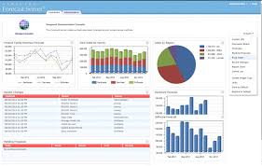
Media (Paid, Earned & Owned) Mix Modeling at Large Scale
Leading Home Appliances and Repair Services Provider
The Problem: Media mix spend effectiveness (revenue generated per dollar of spend) had declined by 5% for 2 consecutive years
The “Before” State
LatentView Solution
The “After” State
Media budget allocation was done on an aggregated, unoptimized basis and thus the cost per acquisition was much higher as compared to industry benchmarks
Created multi-variate linear models for paid channels and attribution models for non-paid channels which were further optimized at a product and channel level
By implementing the recommendations from the Media Mix Model (MMM), revenue increased by 1.9% for Home Repair and 2.3% for Home Improvement in a six-month period
Data Sources
Predictive Models
3 Business Units – HI, IHR & PD
Marketing Levels: Products (P) x Channels (C) x DMAs (D)
Paid Channels: Linear Models
Non-Paid Channels: Attribution Models
3546 Models built for BU1, 2376 Models built for BU2, 1218 Models built for BU3
Bing AdWords
Processed Data Marts
Google AdWords & Analytics
Ciboodle
Aggregated Weekly Data
Clustered Data
Omniture
Yahoo Adwords
Response Curves
Projecting the ‘Revenue - Growth Rate’ as a function of Cost in the form of ‘S Curve’.
Discovering the ‘Optimal Range’ of Spend Limits
POS
Meta Data @ Zip Code & Daily
Optimization Tool
10
Notes:
Sears – Media Mix Modelling
Business Objective:
Analytical solution to develop a media strategy in the digital space. The repair market was the key target area
The objective was to optimize marketing spend by allocating dollars to different marketing channels in order to maximize revenue.
LatentView Solution:
LatentView built a regression model for different channels using clicks as IDV to determine the equation that best defines the relation
The Solution included finding optimized spends across all channels
The data was then analyzed and various Key insights and recommendations were presented
Business Benefits:
The Marketing team could use the predictive models to optimally allocate budgets to maximize ROI
Seasonality trends were identified to optimize spends
Customer attribution analysis help reallocate revenue to the first interaction channels
Optimized spends could now be tackled at a national and metro area level
In Home Repair
Marketing Plan MMM Tool Recommendation
Spend Revenue Spend Revenue % Increase in Revenue
Oct-16 $ 993,645.93 $ 6,068,482.66 $ 993,645.93 $ 6,171,075.30 1.69%
Nov-16 $ 977,109.36 $ 5,962,044.50 $ 977,108.97 $ 6,069,487.09 1.80%
Dec-16 $ 962,170.84 $ 6,949,069.31 $ 962,171.00 $ 7,021,408.07 1.04%
Jan-17 $ 713,704.56 $ 4,964,827.14 $ 713,704.56 $ 5,267,162.26 6.09%
Feb-17 $ 1,322,296.00 $ 6,396,758.70 $ 1,322,296.00 $ 6,480,428.72 1.31%
Mar-17 $ 1,537,296.00 $ 7,764,377.07 $ 1,537,295.00 $ 7,883,590.29 1.54%
Apr-17 $ 1,597,296.00 $ 6,646,772.38 $ 1,597,296.00 $ 6,713,611.94 1.01%
Total $ 8,103,518.69 $ 44,752,331.76 $ 8,103,517.46 $ 45,606,763.67 1.91%
Home Improvement
Marketing Plan MMM Tool Recommendation
Spend Revenue Spend Revenue % Increase in Revenue
Dec-16 $ 3,033,318.24 $ 29,367,635.26 $ 3,033,318.00 $ 29,929,169.26 1.91%
Jan-17 $ 3,033,318.24 $ 30,867,677.34 $ 3,033,318.00 $ 31,524,870.79 2.13%
Feb-17 $ 3,479,150.41 $ 33,179,330.81 $ 3,479,150.00 $ 34,638,447.22 4.40%
Mar-17 $ 4,522,939.34 $ 43,564,916.36 $ 4,522,939.00 $ 44,065,445.80 1.15%
Total $ 14,068,726.23 $ 136,979,559.77 $ 14,068,725.00 $ 140,157,933.07 2.32%

Slide 11







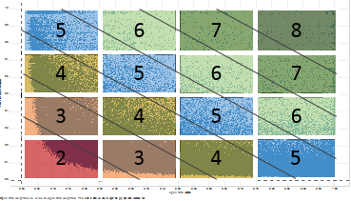
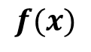
Contact Optimization to Improve Campaign Response Rates
Large International Airline Company
The Problem: For email campaigns, an important communication medium, the open rates among loyalty customers were 3%
The “Before” State
LatentView Solution
The “After” State
Customers received a certain number of emails as defined by business rules, once in 6 months. Lack of personalization resulted in low open rates
Dynamic segmentation based on customer’s past behavior helped optimize the number of emails sent per week. Collaborative filtering techniques were used to personalize email content for customer segments
2% increase in email open rates, 5% higher clicks per customer, which led to an increase of 3% in air revenue
Member Capacity Optimization
Member Content Optimization
$$f(x)$$
Customer engagement data
Open rate
Click through rate
Customer profile data
Propensity Model
Collaborative Filtering
Product | Propensity
Fare Sale | 0.734
Bundles | 0.562
AirMiles Club | 0.323
Chase | 1
Hotel | 2
Optimized Member Capacity
Optimized Content
11
Notes:
United Airlines – Contact Optimization
Business Objective:
To run a propensity model and identify which products to improve customer marketing interaction
LatentView solution:
Methodology
Data level/Granularity:
Based on customer transaction data, a propensity score to be calculated at a product level for each customer, Other variables such as age, gender, status, profit score, chase card status etc.
Recency:
Recency factor to be considered to improve propensity score accuracy
Model/Algorithm:
Propensity Calculation with Logistic regression / Classification Trees / K –Means Clustering
Business Benefit:
Increase in overall customers’ email engagement
Optimal email capacity identification for each customer
Customers targeted with relevant emails
Reduced lost opportunity yielding higher revenue
Decrease in un-subscriptions

Slide 12
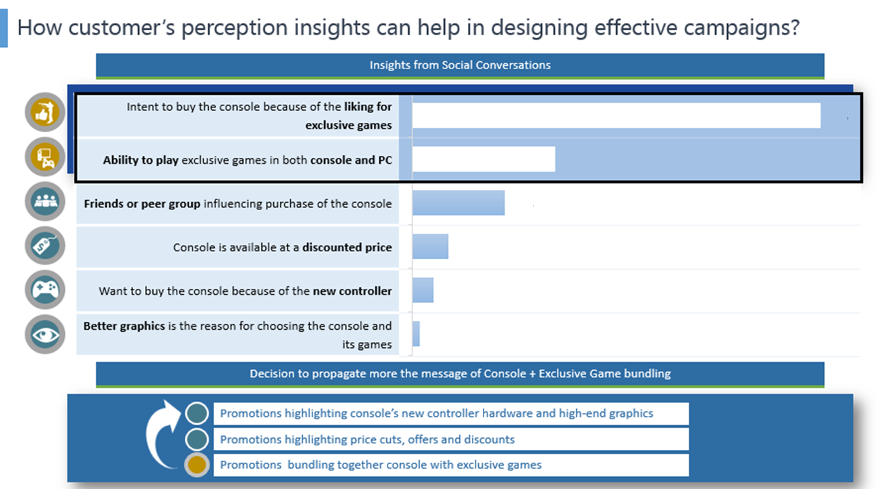




Social Insights → Product Bundling → Higher Purchase
A Global Technology Devices & Software Firm
The Problem: In a polarized audience market like gaming consoles, understanding drivers for ‘wanting to purchase’ and more importantly reasons for ‘not wanting to buy’ is critical for both converting & retaining customers
The “Before” State
LatentView Solution
The “After” State
Promotions were focused on the new controller, high-end graphics and price cuts, but the company fell short of targeted conversion rates by 15%
Social media data was analyzed to identify ‘what drove purchase’ and ‘what factors dissuaded potential customers from purchasing’ using Natural Language Processing (NLP) algorithms
With the help of social insights, the client reoriented the promotion campaign by bundling exclusive games with console devices thus inducing an increase of 4% in purchase conversions
The Process
Extraction of relevant Social Conversations
Application of Advanced Text Mining Techniques
Identifying Drivers and Deterrents to Purchase
12
Notes:
Microsoft – Xbox vs PS
Business Context:
Post the year-end holiday promotions for gaming console industry, the technology major wanted to have a two-pronged look at the social performance of their gaming console product:
Analyze the unprompted reasons cited by social media users for wanting to purchase their console and also the barriers they alluded to for not wanting to buy it.
Compare and contrast the insights with those of competitor’s console to clearly identify the areas that have worked out in favor of the client and those that have not.
LatentView Solution:
Data Extraction: Tens of millions of social conversations spoken about the client’s and competitor’s gaming consoles during the holiday period were extracted
RegEx based ‘Bag of Keywords’: A regular expression (RegEx) based stringent ‘Bag of keywords’ approach was used to isolate the relevant intent to purchase/barriers to purchase conversations from the overall gaming console conversations
Text mining techniques such as topic modelling, feature tagging and positive-negative emotion classification were employed to unearth drivers and deterrents to purchasing the gaming consoles
Business Benefits:
The social media answers helped client in reaffirming the positives of their console and in gaining visibility into its main pain points
Good lineup of exclusive gaming titles was the top draw for buying the client’s product
The competitor fared better in terms of strong existing community that uses its brand - Either the users were brand loyalists of the competitor or the ‘friends/peers’ of users already owned it and hence they wanted to buy it as well
While console update & connection issues plagued our client, the lack of exclusive gaming titles and the dislike for the current non-exclusive gaming titles were dominating the competitor’s negative social space

Slide 13
Campaign Optimization with Algorithmic Bidding
Top 5 Comparison Shopping Engine
The Problem: Improving bid effectiveness is critical in the client context as there were 10+ web properties in 6 countries, covering over 500 million keywords across numerous campaigns with PPC ad-budgets of over $ 100 million
The “Before” State
LatentView Solution
The “After” State
Client wanted to move away from a manual, spreadsheet-based keyword bidding approach to a more automated one, and capture value from bids that are currently sub-optimal
Created a self-service software platform comprising data preparation, predictive modeling (ensembles of NN, GBM & Random Forests) and model scoring with every day refresh for fast moving key words
The automated bidding platform provided a 20% lift in terms of net revenue, with over $10 million in the first year
Click-stream
Predictive Modelling Engine
Ensembles of neural networks, gradient boosting, random forests (1.5k models)
Models for different properties, segments, covariates vs factors
Keyword Bidding
High, medium, low volume bids
Activating archived and very low volume keywords
For various properties across geographies
Landing Page
Product Attributes
Scoring Engine
Score data every few hours
Scores deployed by property, type of keywords, experiment groups
Test & Learn Experimentation
Continuous testing and changing of bids through experiment design
Contests to evaluate various bidding strategies by controlling several factors
PPC Attributes
Offers
Model Lifecycle Management
Hyper parameter tuning
Track model performance metrics
Evaluate shelf life of models
Reporting & Insights
Executive Reporting
Analytical Reporting
Operational Reporting
13
Data Sources
Data Mart
Advanced Analytics Engine
Decision Management
Notes:
Shopzilla – Automated Bid Optimization
Business Objective:
Client is a top-5 comparison shopping engine, with PPC ad-budgets of over $100 MM, for over 10 web properties in 6 countries, covering over 500 MM keywords across numerous campaigns / ad groups
Client wanted to move away from a manual, spreadsheet-based keyword bidding approach to a more automated one, and capture value from bids that are currently suboptimal.
LatentView solution:
LatentView created a software system that comprised of data preparation, predictive modeling, model scoring:
Ensemble modeling with neural networks, gradient boosting and random forests to predict revenue per click and redirect rate, based on: transaction history, landing page characteristics, seasonality, etc. (1000’s of models)
Automated Hyper-parameter tuning using grid search algorithms
Bi-modal modeling – one set of models refresh every day for fast-moving keywords, and one refreshes every two weeks
Business Benefit:
The automated bidding platform provided a 20% lift in terms of net revenue, with over 10MM $ in the first year
Enabled analysts to focus on scenario analysis, rather than operational aspects of keyword bidding
Massive improvement in quality of bids, ability to respond fast to changing marketplace, are some of the other benefits

Slide 14
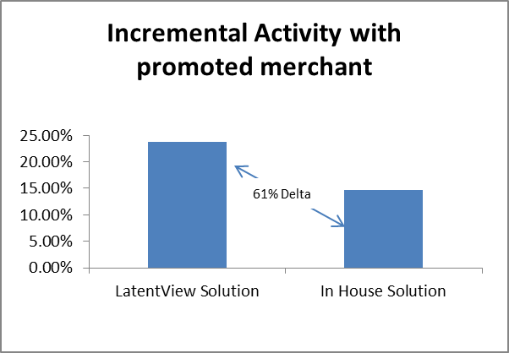




Personalized Targeting using Look-Alike Modeling
Leading Online Payments Company
The Problem: Lack of a scientific data-driven approach to targeting customers for new campaigns
The “Before” State
LatentView Solution
The “After” State
The marketing team targeted customers based on pre-set rules which did not take into account past behavior, thus having a negative impact on campaign effectiveness
Created look-alike models using logistic regression techniques so as to target the right customers for campaigns
Identification of target population who have a higher propensity to respond to specific campaigns on large merchant offers drove incremental revenue of $0.5 million
Model performance
Who are more likely to respond?
Campaign performance
Purchased previously in Fashion vertical
Metrics | Value
Target Size | 950K
Incr. Rev per Account | $ 0.57
Incr. Rev % | 2%
Total Incr. Rev | $555,236
Opened their emails in the last 3 months
Active in more than 6 of the last 12 months
Females with age between 20 and 40 years
14
Notes:
Paypal – Personalized Targeting of customers
Business Objective:
Personalized Targeting of customers based on past transactions
Business Benefits:
Business impact: 51% increase in open rates during the post campaign period
Helped identify keywords/themes & optimal length for subject lines
Helped gauge negative influence of email by analyzing spam marking and unsub clicks

Slide 15











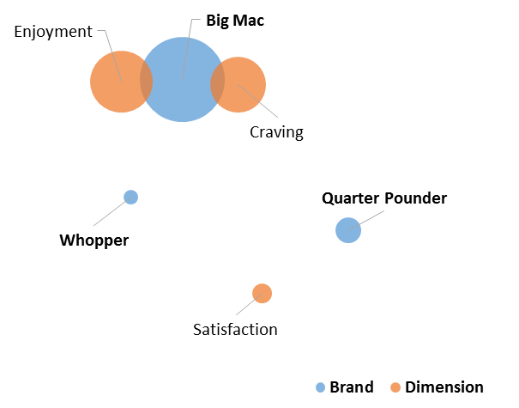




Unbiased Perception Mapping Through Social Data
Leading Global Food Chain
The Problem: Survey-based brand perception analysis is costly, slow and typically leads to biased conclusions
The “Before” State
LatentView Solution
The “After” State
Customer perceptions of product and competitor products analyzed through detailed, time consuming surveys
Identified themes and developed product feature association map(s) based on discussion context and geography using social media conversations
3% lift in effectiveness of marketing campaigns as measured by key response and engagement metrics due to specific brand management initiatives
Lexical Analysis
Analysis on Structured Data
Benchmarking
Unstructured Data
Keywords Generation & Data Extraction
(through secondary research and Radian6 Extraction)
Brand Q
Brand X
Brand Y
N-Grams Extraction
Generate Unigrams, Bi-Grams and Tri-Grams (e.g. “party”, “meet up”, “looking forward to” etc.)
Brand Z
Dimension Tagging
(“love to eat”, “long for” , “miss so much” = Craving)
Brand Association
Key Takeaways
Ontologies
(Domain-specific Concepts and Relationships)
Reconciliation
(using keyword mappings)
Validation
(manual checks on random samples )
15
Notes:
McDonalds – Social Media Analysis
Business Objective
To use social media conversations to understand the relative perceptions of client’s core products and its competitors’ products and also its overall brand perception in four regions – the US, the UK, Canada and Australia.
The core products include two types of burgers, Chicken Nuggets and French Fries.
LatentView’s Solution
Identify themes based on the context of discussions and segment comments by geography.
Develop product feature association map(s) for each product and its respective competitive products.
Identify people sentiments (Positive/Negative) for each product and its respective competitive products.
Business Benefits
Identifies major competitors product-wise and helps to understand the competitors’ scoring areas.
Helps the client to position the core products better.
Identifies the right customer segments and the dimensions that impact product preference.
Helps the client to perform better marketing activities by targeting specific dimensions.

Slide 16


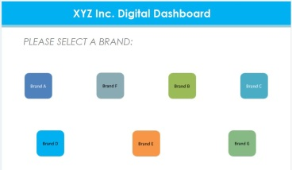



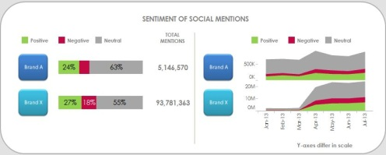
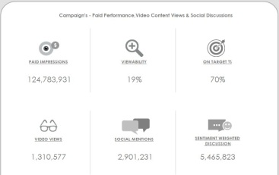
360-Degree View of Digital Metrics to Improve Marketing Effectiveness
Leading Global Food & Beverages Corporation
The Problem: In the CPG industry, lack of a unified view of marketing data can result in incorrect analysis and wrong conclusions, thus leading to “throwing good money after bad” situation with respect to marketing spends
The “Before” State
LatentView’s Solution
The “After” State
Siloed platforms provided a disjointed view of marketing effectiveness resulting in a protracted test cycle for campaigns
Built an integrated dashboard with paid, earned and owned media metrics that facilitates cross-channel, cross-brand and cross-campaign comparison to gain deeper marketing insights
Test cycle for campaigns reduced by 25%, thus resulting in a decrease in cost per campaign by as much as 8%
Automated Integrated System
Enterprise Data Architecture
Cloud-based reporting system
Extraction
Warehouse
Presentation
Key metrics:
Historical data
Flat Files
ETL
Content marketing - Likes, Posts, retweets, re-pins, comments etc.
Web traffic & audience engagement - Site visits, Sessions, Session duration, Page visit depth etc.
Video ad – Views, Viewer growth, Subscribers, likes, dislikes etc.
Paid campaign – Impressions, Viewability rate etc.
Social buzz – Mentions, brand sentiments etc.
API
Extraction
Transformation
Loading
API
API
Meta data
To dashboards
API
Raw data
Summary data
Data Sources
Staging tables
Data mart
16
Notes:
Pepsi - DigiView
Business Objective:
To build a single-viewed automated real-time application that enables CXOs to make quick data-driven insights from a company’s digital & social marketing efforts that cut across their Paid, Earned & Owned media spectrums.
LatentView Solution:
Integrated data from five different data sources and built 11 comprehensive interlinked dashboards that give both a snapshot view and a deep dive view of their trademarks’/brands’ online presence, content marketing messages, customer perception and campaigns’ performance within their portfolio & against their competitors.
Business Benefits:
Automated real-time business intelligence application provided the client an opportunity to view their brands’ social & digital marketing efforts in visually appealing & feature-rich Tableau dashboards.

Slide 17
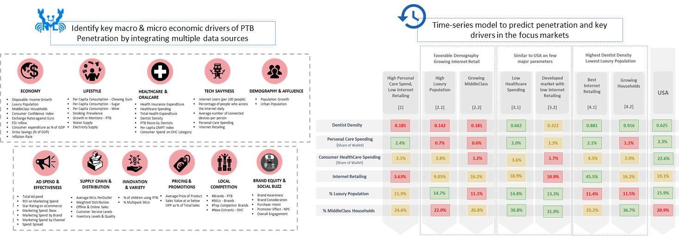
Analytics to Maximize Market Penetration for New Products Launch
Consumer Lifestyle Electronics Firm
The Problem: 60% of new product introductions in the consumer lifestyle space fail to take off due to wrong markets/positioning, resulting in losses running into billions of dollars
The “Before” State
LatentView Solution
The “After” State
Time-to-market was protracted as there was no scientific way in measuring expected success of new product launches
Identified key factors influencing PTB sales using Bayesian models, prioritized markets based on customer propensity and provided a self-service scenario analyzer tool to optimize resource allocation
Go/No-Go decision timeline for new product launches was cut by half and the ‘Go’ decisions taken were far more resilient to market dynamics as it addressed the root causes
17
Notes:
Philips Market Penetration Analysis
Business Objective:
Identify the key macro & micro drives of PTB penetration in five focus markets
Focus on existing markets and identify new markets for engagement at macro level
To allocate resources in individual markets based on the key micro drivers identified
LatentView Solution:
Identify key macro & micro drivers using Causal & Bayesian Models
Prioritize existing markets using Rank Order Algorithm
Identify & prioritize new markets using Cluster Analysis
Optimize resource allocation using Optimization Framework
Business Benefits:
Provide framework to prioritize existing markets and identify new markets using Cluster Dendogram
Optimize resource allocation within specific countries to maximise penetration
Create a comprehensive snapshot of the key drives that impact business goals

Slide 18
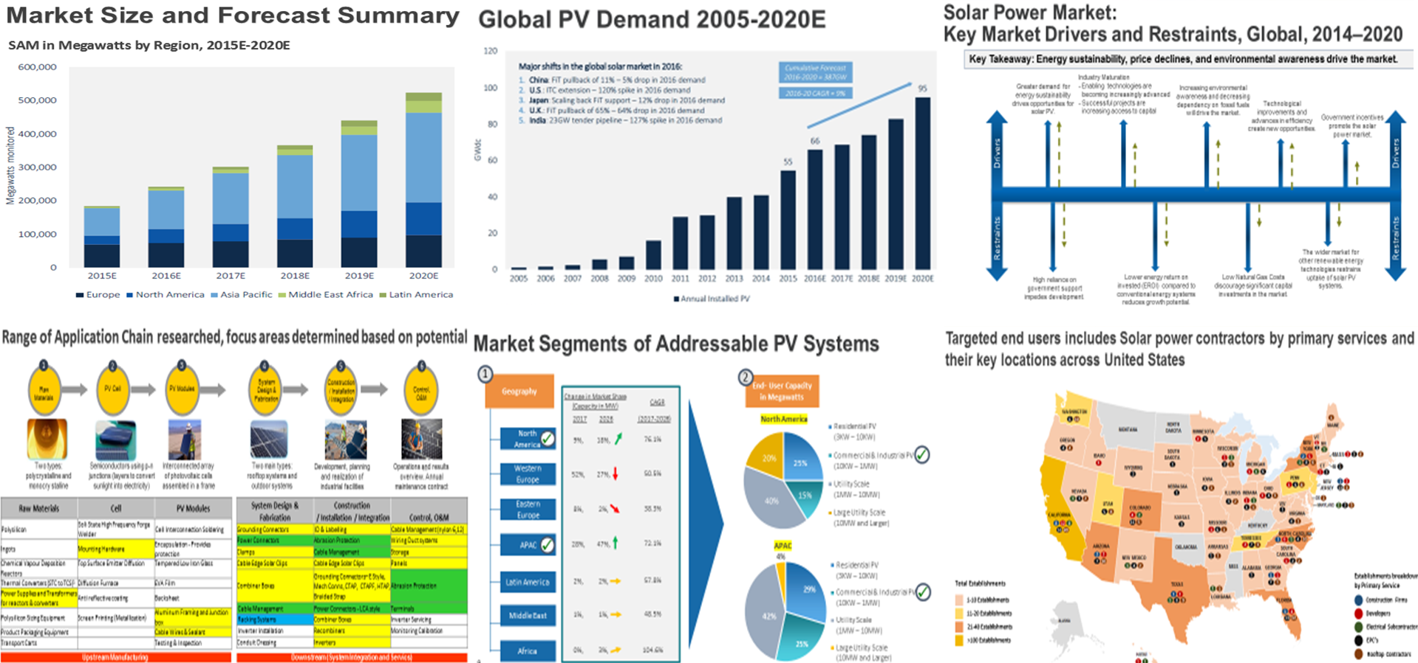
New Market Entry Assessment
Leading Global Physical Infrastructure Equipment Manufacturer
The Problem: Our client sought to understand the market dynamics, industry value chain, competitive scenario and target end-users for its infrastructure equipment products in order to enter the Solar Power industry in the US
The “Before” State
LatentView Solution
The “After” State
Client did not have a presence in the solar power industry and wanted to establish the same via existing and new product development to increase market penetration
Provided detailed analysis of market size, product segmentation, drivers, end-users and product demand to enter the market through secondary research, data-driven insights
Client launched the product in the new vertical and recorded ~5% increase in sales via new business vertical. Gradual increased profitability margin by understanding geographical reach and customer base
Notes:
Panduit

Slide 19
‘Digital’ Case Studies
19

Slide 20



High Volume ClickStream Analytics to Monetize Search Page Ads
American Multinational Technology Giant
The Problem: Client’s revenue per user in finance was 25% lower than revenue per user for travel related searches
The “Before” State
LatentView Solution
The “After” State
i
Average revenue per click per user for financial stock related search terms was 30% lower for our client’s search engine as compared to competitor
Built a high volume, high throughput clickstream data pipeline that combined demographics, search and browsing data to suggest the right ads and its placement to improve customer experience
Relevant ad impressions on financial stock searches increased by 33% which combined with a 5% increase in click through rate resulted in an additional monetization opportunity of $15 million annually
Convert unstructured data to structured data
Scalability – capable of processing 1 TB in 24 hours
Cost Effective – Optimized to reduce infrastructure cost
Competitor Analysis – comparison of features and click through rate between Client and Competitor
Products Catalog, Coverage & Click through rate
Form Factor & Browser Influence on consumer behavior
User Switching – Identify factors influencing user switching between Client and Competitor
Analysis
Clickstream Analysis
20
Notes:
Microsoft Panel Miner
Business Objective:
Help identify signals that influence the whole user search experience and also increase the user engagement on client’s search engine
LatentView Solution:
LatentView’s Panel Miner solution was applied to convert unstructured HTML data to structured tabular data
LV’s seamless data processing pipeline is composed of ETL operations followed by Hadoop processing and finally migration to database for storage and reporting
Over 300 GB per week of data is hosted in AWS cloud environment
Web dashboards and automated Excel reports were built for reporting of outputs
Business Benefit:
Weekly reports on the feature coverage, feature distribution, CTR(Click Through Rates) of search result pages along with competition to benchmark key performance differentiators
Weekly news flash on new features introduced by competition, their Ad footprint to measure key performance indicators such as ad density, ad impression yield that can influence decisions taken by Product Planning Group.
Deep dive analysis of Click Stream data to infer users position in purchase funnel and thereby identify signals
Selected for Presentation in AWS Re-Invent-2014
For 4.5M searches per month, with 12% of them clicking through to brokerage sites, assuming an ad revenue of $1 - $6 per click, potential monetization benefit realized is between $3M to $18M annually

Slide 21
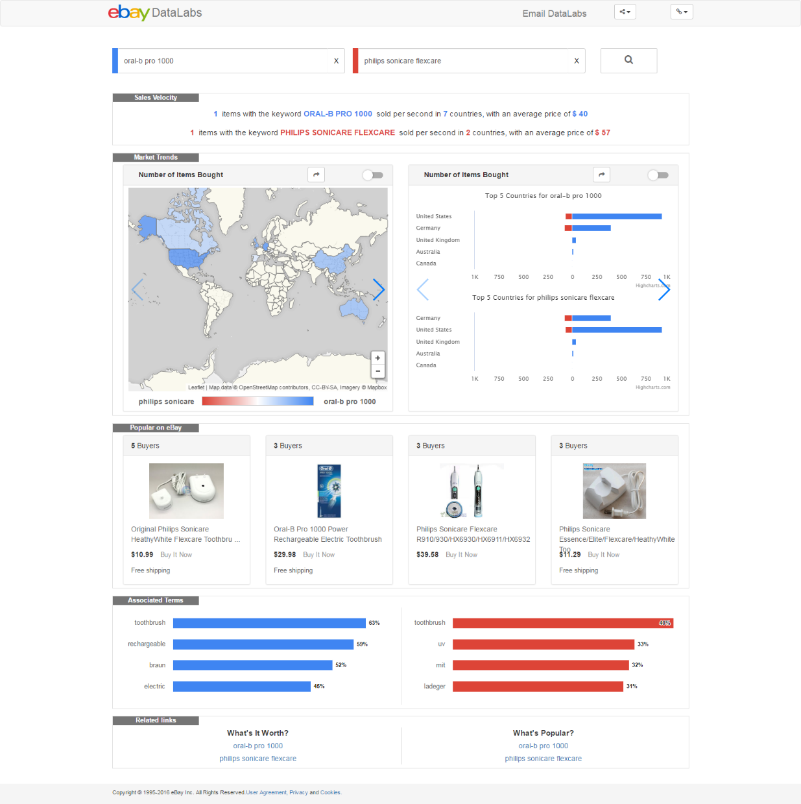
Real-time Visibility to Transaction Trends in Ecommerce Marketplace
Multinational E-Commerce Corporation
The Problem: Visualizing the collective intelligence of buyers/sellers enhances the “interestingness” of the market place and drives higher transaction volumes
The “Before” State
LatentView Solution
The “After” State
Client did not have a common platform which buyers/sellers could use to understand what the popular products were and how they were trending across geographies
LatentView built a real-time platform to visualize market trends, purchase trends, popular items etc. for any search/product term and allows comparison between products and product categories
In three months following the implementation of the platform, transaction volumes for key products showed an uptick to the extent of 3% for certain categories
Popular Products
Sales Velocity
Associated Terms
Spatial & Temporal Trends
21
Notes:
Ebay – Everywhere
Business Objective:
To visualize purchase trends in an e-commerce company over time, spatial trends, popular items etc. from 4TB of historic transaction data over 3 years with a response time lesser than 1000 ms
Business benefits:
Identifying High Potential Markets, red ocean markets , markets with high demand but unexplored by rivals
Identifying popular & trending products across brands
Market – wise price comparison
Changes in price vs volume

Slide 22
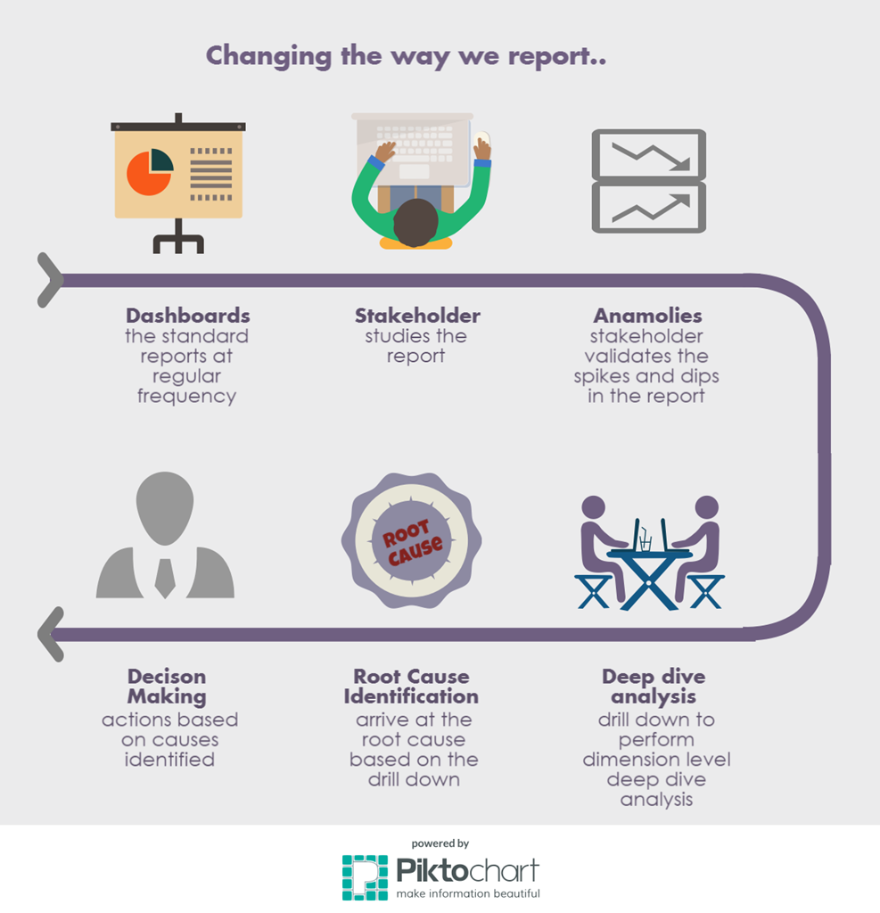




Automated Anomaly Detection through Multi-Level Forecasting
Multinational E-Commerce Corporation
The Problem: Manual effort in identifying errors in reports can take up to 20% of time for key analysts, thus reducing productivity
The “Before” State
LatentView Solution
The “After” State
Manual validation of KPIs across hundreds of reports and detection of anomalies was not only time-consuming, but also prone to human error
Built an automated time forecasting tool which helped identify anomalies across various levels of granularity in key analysis dimensions
70% reduction in the time-taken to detect anomalies resulted in increased efficiency of analysts and better decisions as manual errors were eliminated
Anomaly Detection
Exception Score Calculation
Three components are used in calculating the score
AUTOMATED
Recent Trend
Seasonality
Daily Variance
Exception Status
Based on combined scores, thresholds are defined to flag exceptions
22
Notes:
Ebay – Anomaly Detection System
Business Objective:
Track the KPIs closely and identify anomalies across dimensions to enable quick decision making .Traditional reporting needs extra efforts to bring out anomalies across dimensions (Geographies, Seller Type, Category etc) as the process is Manual, Time consuming and Prone to missing combinations
LatentView solution:
PART (Pattern Recognition Tool) helps in identifying anomalies across various combination of segments and sends alert to stakeholders
Detects and flag anomalies
Share list of anomalies using email alerts with stakeholders
Tableau Dashboard generated helps in analyzing the root-cause
Business benefits:
Anomaly detection using PART (Pattern Analyzer & Reporting Tool) has helped in identifying the anomalies early and minimizing losses for an e-commerce giant.
Benefits of using PART in detecting anomalies:
Automated detection of anomalies
Early Flagging to the stakeholders
Comprehensive in captures anomalies

Slide 23




Digital Roadmap for Website-led Customer Acquisition
Leading Baby Food Nutrition Company
The Problem: Website enrollments/conversion rate of moms in key markets (US & Canada) was at a low 15% and was stagnant for two years
The “Before” State
LatentView Solution
The “After” State
Lack of a unified view on website activity resulting in little or no insights on improving customer engagement and personalization at the Zero Moment of Truth (ZMOT)
Built a comprehensive web analytics maturity framework covering enrollments, engagement and personalization and implemented it across markets
Website enrollment jumped to 19% on an average going up to 22% in certain markets like Canada and US with commensurate increase in website engagement levels
Tracking web enrolment journey
Website tagging
Website experimentation
Insights generation
Tracked enrollment funnel from the source till conversion and recommended solution at each step
Tagged the website to track the key metrics for all the website
Set up website experiments via Google Analytics and Optimize to do A/B testing
Recommended insights for each markets on a monthly basis to improve enrollment and engagement across markets
23
Notes:
Mead Johnson – Web Analytics
Business Objective:
As part of their digital transformation, our client wanted to drive enrollments & engagement through the website and hence needed a comprehensive web analytics platform
LatentView Solution:
Recommend KPIs to be tracked for all Markets
Analyse the web behaviour of users and recommended actionable insights
Build live online dashboard for KPI reporting for each market
Business Benefits:
Corrected the tracking accuracy of enrollment form conversion rate from 78% to an actual of 32% for CA
Identified prime reasons for enrollment form abandonment as Password field and Date of Birth field for CA and MX websites respectively
Discovered that 10% more users drop-off on Mobile forms than Desktop because of the lengthier Mobile form

Slide 24
‘Innovation’ Case Studies
24

Slide 25


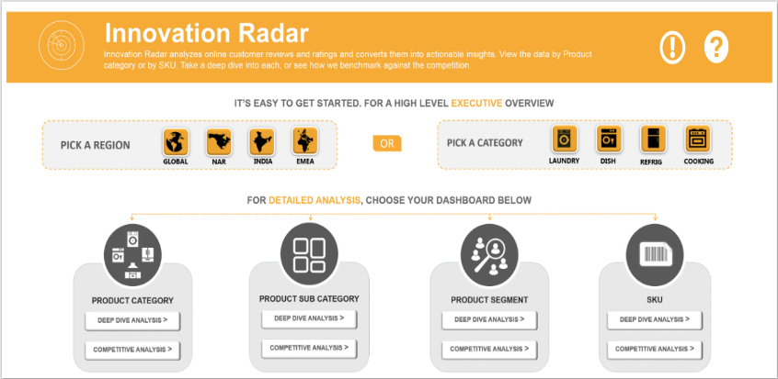









Data driven Product Innovation based on Consumer Reviews
Largest Home Appliances Manufacturer in US
The Problem: Lack of/Delayed access to direct customer feedback on their products and competitors’ can adversely affect a consumer durable company’s ability to innovate and keep customers happy
The “Before” State
LatentView Solution
The “After” State
Purchase drivers were determined by post-facto analysis of POS data at stores and survey data resulting in delays of up to eight months to get consumer feedback on product features
Built a real-time text analytics platform to consolidate external, unstructured data to ‘measure’ customer feedback of client’s brand with respect to competition on various parameters that drives purchase
Precise, fine-tuned innovation on product features and messaging was possible on an ongoing basis as consumer feedback reached the teams directly within 2.5 months of product launch
Industry Forums
Sentiment Analysis
Data Focus
Drivers of Purchase
Market Places
Int
Triggers of Purchase
Ext
Expert Opinion
Unstruct.
Struct.
Brand Websites
Consumer Rating
Popular Features
Demo Link
Data Extraction & Data Landscape
Text Analytics
SAS VA Dashboards
25
Notes:
Whirlpool Innovation Radar
Business Objective:
Mine Innovation focused insights from Internal Structured data like Surveys, External Unstructured data like Customer Reviews, Ratings, Expert Reviews etc.
To compare & contrast competitor activity and benchmark whirlpool against competitors in terms of Innovation, Sentiment etc.
LatentView Solution:
Scrape consumer reviews, specifications, features at SKU level from retailer & manufacturer websites using Python
Identify various review dimensions such as Rating, Sentiment and tag the reviews into various categories like Innovation, Purchase drivers using Clara bridge tree
Analyze through intuitively laid dashboards across user roles in SAS VA for insights
Business Benefits:
Identify the context in which Innovation is mentioned (Achieved, Needed)
Identify the emotion / sentiment of the review (Anticipation, Happy, Sad)
Identify the purchase drivers / purchase triggers mentioned (Replace, Upgrade)
Identify the most popular feature / attribute being mentioned (Performance, Ease of Use etc.)
Web link: https://wplprod.ondemand.sas.com/SASVisualAnalyticsViewer/VisualAnalyticsViewer.jsp?reportViewOnly=true&reportName=Landing+Page&reportPath=/WPL/Development/Innovation/Mock/&appSwitcherDisabled=true
Username : wpl0sli
Password : LVfun179

Slide 26
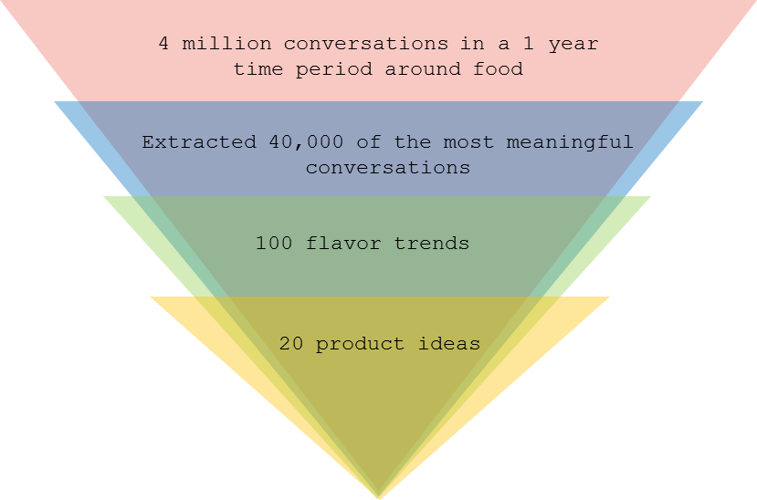
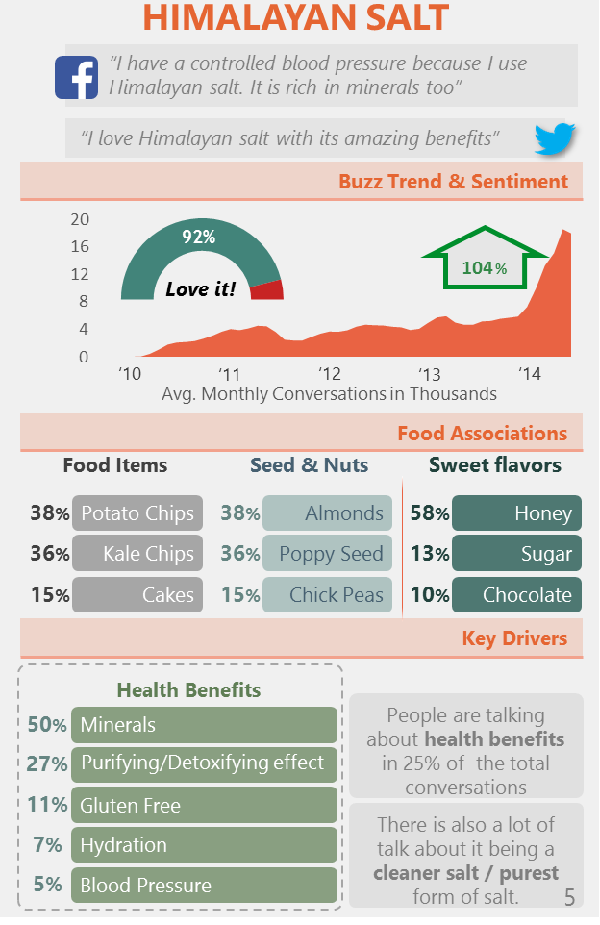
Social Media-based Flavor Trends driving Product Innovation
Leading US Based Beverages & Snack Manufacturer
The Problem: Our client’s market-share was down by 6% due to the delay in introducing new snack flavors as smaller, local competitors had a much faster time-to-market innovation cycle
The “Before” State
LatentView Solution
The “After” State
Flavor trends were identified based on surveys and focus group studies which were costly, time-consuming and lacked real-world generalization
Social media conversations were mined to identify emerging flavors and the underlying emotional and functional drivers associated with them
Reduced innovation cycle time by 1.5x, identified 20 flavors at a fraction of ideation cost and gained a big first-mover advantage
led to
26
Notes:
Pepsi – Flavour Trend Analysis
Business Objective:
Explore social media conversations to identify emerging ingredients in Breads, Muffins, Spreads and fillings.
Understand how a complete meal is split into different individual components and comprehend people’s mind-set on these components
LatentView Solution:
An exhaustive list of bread varieties was compiled based on market research and social media conversations were extracted for nearly 2 quarters.
Identify various ingredients or combination of ingredients based breads
Segregate the constantly emerging and seasonally emerging flavors/ingredients based on historical data
Business Benefits:
Stay close to the emotions and excitement of the consumers by studying their food habits.
Early indication of bubbling trends to increase competitive advantage
Sharpen the focus for primary research just on the flavors which has an increasing trend of buzz
Time to market is shortened.

Slide 27
‘Supply Chain’ Case Studies
27

Slide 28
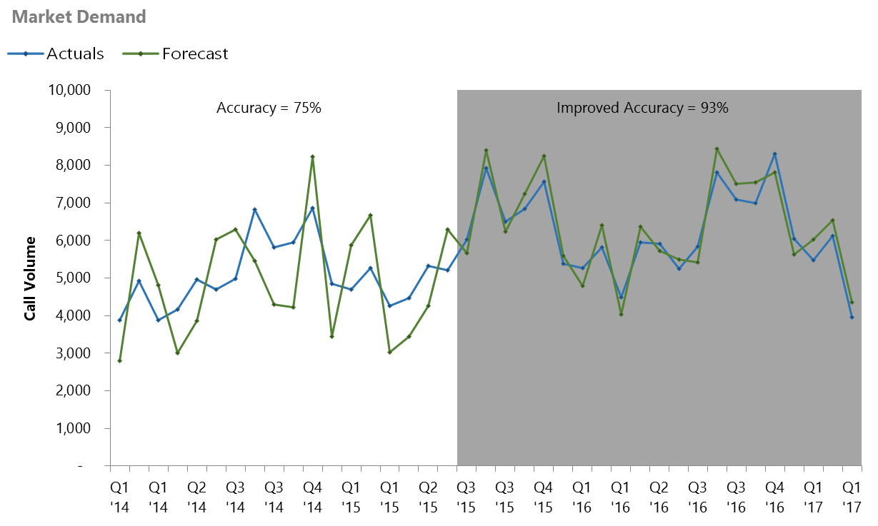
Demand Forecasting to Improve Service Delivery
Leading Home Appliances and Repair Services Provider
The Problem: Inaccurate demand plans results in poor service levels which was at a low 45% for our customer
The “Before” State
LatentView Solution
The “After” State
Combined forecasts from different algorithms (ARIMA, ETS, TBATS or Holt-Winters) to boost accuracy. Forecasts were evaluated monthly and recalibrated as appropriate
Demand forecasting accuracy up to 92% from 65% reducing lead time by 20%. 4% increase in First Time Completes resulting in an incremental revenue of $5 million per annum due to reduced cancellations
Rudimentary forecasting process with each function operating with a different view of overall demand, thus resulting in inefficient service delivery process
Measure accuracy, Improve Model
1
2
Data gathering & business inputs
Baseline forecast
generation
4
Finalize forecast and Demand plan
3
Executive review and Consensus demand
28
Notes:
Sears – 95/5 – Demand Forecasting

Slide 29
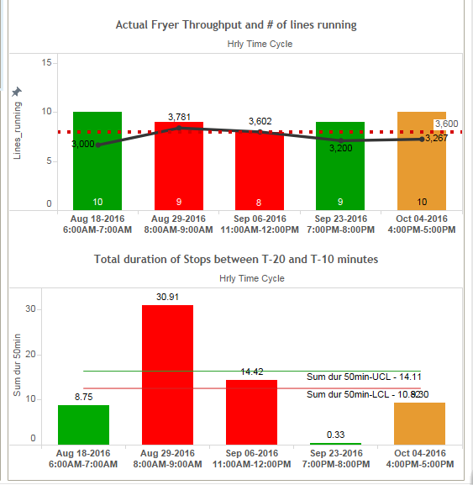






Increasing Manufacturing Throughput Thro’ Machine Learning
Leading Snack Company
The Problem: Low capacity utilization of expensive equipment that adversely impacts production throughput to the extent of 6%
The “Before” State
LatentView’s Solution
The “After” State
Large Equipments in the manufacturing line like Fryers for chips operating well below capacity at 90%
Early Warning System based on Logistic Regression to predict downtime in processing line – 30, 60 & 180 minutes in advance
Fryer utilization up to 98.5%
$ 2 million savings in cost per fryer
Potential save of $ 50 Million after rollout to 30 plants across US
I Data Understanding
II Data Preparation
III Model Building
IV Real Time Dashboard
2 Interleaved Master Database
1 Data Sources :
Extracted only 1 hour data prior to target event
Defined Non-Event and Applied various conditions on 1-hour time frame
Packaging Stops
Through put change
Processing Stops
Event Subset file
Non-Event File
Operational Variables
i. Collated file in Time series format
ii. Converted time –series data into cross sectional form
Logistic Regression to predict downtime and throughput reduction and to identify Key Factors
4
3 Data Mart for Model building
29
Notes:
Pepsico – Snack Food Manufacturing Stops
Business Objective:
Develop a systematic, faster & automated hypothesis testing methodology to understand vehicle usage & manage risks. (i.e.)
Identifying Driving Styles, Vehicle Repair, Claim Patterns
Predicting risks in similar / neighboring driving profiles.
LatentView Solution:
Identifying key factors to predict downtime / throughput reduction on hourly basis. Building a real time visualization tool to monitor the key factors and take necessary mitigating actions
Business Benefits:
Additional output gained by predicting downtime ~13000 lbs / month
Incremental wastage reduction ~4500 lbs / month *

Slide 30
‘Business Performance’ Case Studies
30

Slide 31
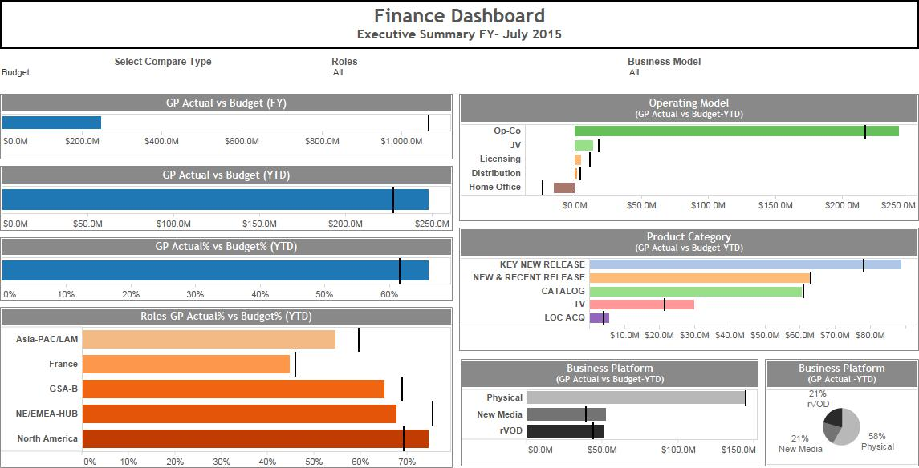
Global Performance Measurement Dashboard for CFO
Global Record Company
The Problem: For a CFO, up-to-date performance metrics are key to decision making and our client had a rudimentary manual setup
The “Before” State
LatentView Solution
The “After” State
Performance data was analyzed using excel sheets which did not provide the required slicing and dicing capabilities to identify and correct underperformance of products and categories
Build an intuitive, actionable visualization tool that provided insights into which categories and geographies were underperforming and identify the causal factors for improvement
Improvement plans to achieve the forecasted numbers were formulated much faster saving almost 30% in analysis and turn-around time
Select the metrics on which the Overview has to be filtered
Actuals vs Budget – Operating Model & Product Category Split
Actuals vs Budget – Overalls & Regional Split
Actuals vs Budget – Business Platform Split
31
Notes:
Sony – CFO Dashboard
Business Objective:
A one stop dashboard to track & measure performance of all business units across geographies
LatentView Solution:
Overview of the current year metrics along with deep-dive analysis into each segment
Analysing data on multiple levels gives insight into which categories or which geographies are underperforming
Understand the factors that cause the disparity between actuals and estimates and create an action plan to achieve the forecasts
Business benefits:
Measure the best performing KPI’s across each category in a single view
The drill down’s help dissect the overall performance into category level which throws light into specifics of each category
The waterfalls shows the components of loss in an easy way to understand, allowing to analyze the reasons behind the losses

Slide 32
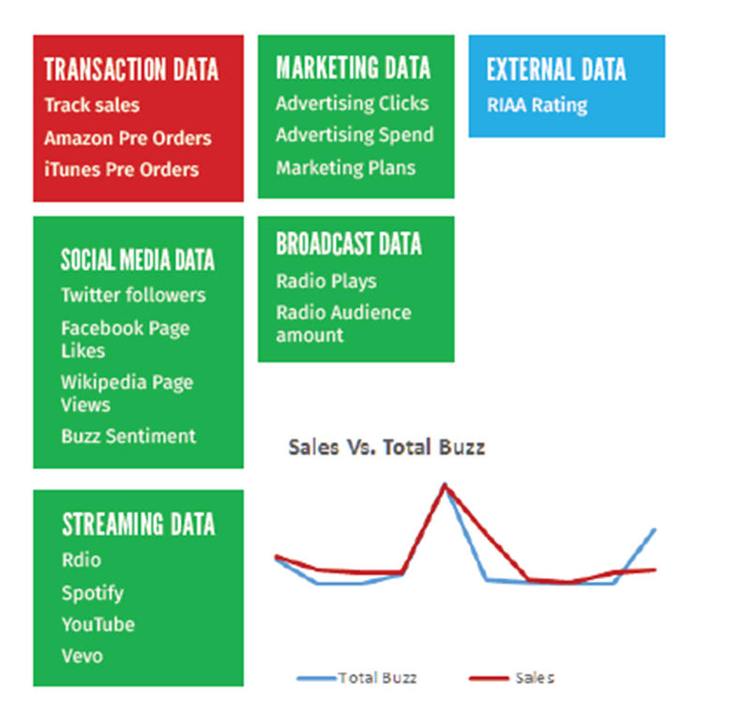
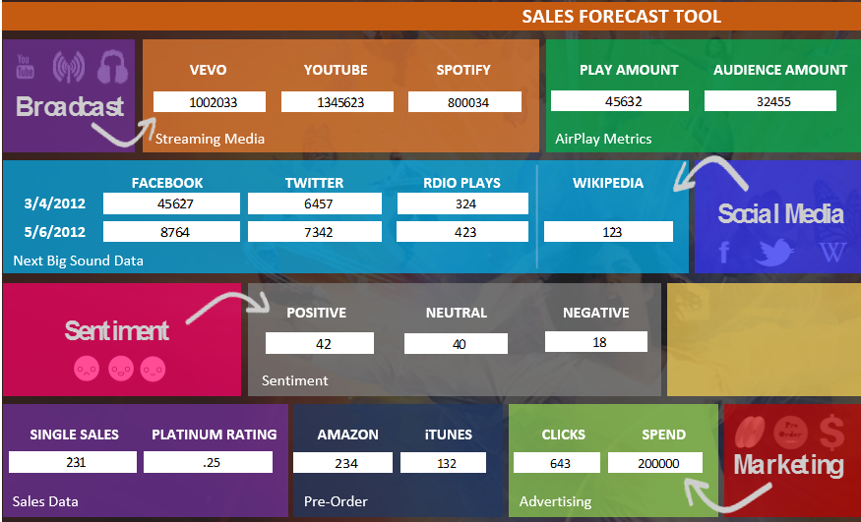
Driving Profits in a Highly Competitive Landscape
Leading Media & Entertainment Company
The Problem: In the music industry where first week sales has a big impact on overall profitability, this company’s predictions were only 60% accurate thus leaving ‘money on the table’
The “Before” State
LatentView Solution
The “After” State
Models built with internal transactional data were not accurate in the real world
Created a prediction ensemble utilizing multivariate regression with attributes describing how people ‘engage’ with music in the social space
Increase the accuracy of sales forecast model from 60% to 97% for 133 artists across 10 genres thereby increasing profits and optimize supply chain
Drives
32
Notes:
Sony Music – Forecast Sales
Business Objective:
A global record company wanted to build a robust model using digital and social data
to help predict sales of a record as soon as it released. Given the limited number of tracks/albums an artist will have in their history, the challenge was to develop a forecasting technique that would improve accuracy of prediction.
LatentView Solution:
Since the number of data points were low and the predictors were high, we created multiple subsets of predictors. Using an ensemble technique with multivariate regression we built a model to predict sales.
We analyzed social media data that helped understand buzz and customer sentiment, transaction data that tracked pre-orders, streaming data that helped understand what the audience was listening to, broadcast data such as radio plays and marketing data.
The past performance, social media activities, listenership across channels and pre-launch data of hundreds of artists were analyzed.
Furthermore, the impact of various marketing and promotional activities were analyzed soon after the album launch in order to quantify and optimize spend.
Business Benefits:
The model was able to predict sales with an 85% accuracy.
It also helped to better their supply chain planning and also have more leverage over retailers in pushing their product based on data.
Furthermore, the company was now able to optimize marketing effectiveness and spend by timing their promotions and tours better, creating social media buzz at the correct time etc.

